Slide 1
Welcome To Our Presentation
Royal Fabrics Ltd.

Slide 2
“Business Plan of textile Fabrics manufacturing”
Presented By
Md. Mahfujur Rahman BBA2201025116
MD Tanvir Hossain BBA2201025103
Sadman Sakib Dipto BBA2201025111
Mahmud Hasan Zayed BBA2201025109
Al Amin BBA2201025108

Slide 3
TABLE OF CONTENTS
1.
Introduction
2.
Company Overview
3.
Industry Analysis
4.
Market Analysis
5.
Marketing strategy
6.
Production Plan
7.
Financial Plan
8.
Accounting Plan
9.
Conclusion
10.
Q&A

Slide 4
1.Introduction
Welcome to Royal Fabrics Ltd. Our premier destination for high-quality textile fabrics
Dedicated to innovation, sustainability, and exceptional customer service

Slide 5
2.Company Overview
Founded by a team of experienced professionals with a proven track record in the textile industry.
Specializing in producing a wide range of textile fabrics including cotton, wool, polyester, and blends.

Slide 6
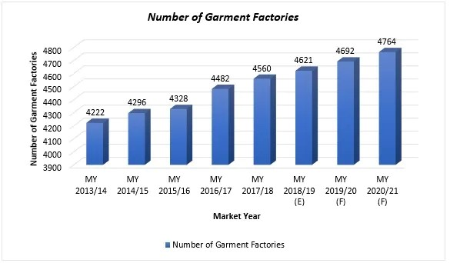
3.Industry Analysis
The textile industry is a key driver of the Bangladesh economy, accounting for over 80% of the country's exports. With a growing population and increasing demand for textiles worldwide, Bangladesh offers a lucrative market opportunity for textile fabrics manufacturing. The industry is projected to grow at a CAGR of 7% from 2021 to 2028, reaching a market size of USD 30 billion by 2028.

Slide 7
4.Market Analysis
Target market includes apparel manufacturers, home furnishing companies, and industrial clients
Multi-channel marketing strategy to reach local, national, and international markets
Commitment to building strong customer relationships and providing personalized service

Slide 8
5.Marketing Strategy
Promoting brand as a reliable and innovative supplier of high-quality textile fabrics
Emphasis on sustainability, quality, and customer satisfaction
Utilizing social media, industry publications, and trade shows for promotion

Slide 9
6.Production Plan
We will utilize state-of-the-art machinery and equipment to produce textile fabrics through a combination of weaving, knitting, dyeing, and finishing processes.
We will establish strategic partnerships with reliable suppliers to ensure a steady and sustainable supply of raw materials such as natural fibers, synthetic yarns, and dyes.
Our team of skilled technicians and operators will undergo comprehensive training programs to enhance their technical proficiency and operational efficiency.

Slide 10
7.Financial Plan
Projections for startup costs, revenue forecasts, and cash flow analysis
Seeking financing through a combination of equity investment, loans, and grants
Commitment to monitoring financial performance and making necessary adjustments for profitability

Slide 11
8.Accounting Plan
We will maintain accurate and timely financial records, including income statements, balance sheets, and cash flow statements.
Implementing robust cost control measures is essential to maximize profitability and operational efficiency.
Compliance with tax regulations is paramount to avoid penalties and maintain financial integrity.
We will implement cash flow forecasting, monitor receivables and payables

Slide 12
9.Conclusion
Royal Fabric Ltd. is poised to be a leading player in textile fabrics manufacturing
Commitment to excellence, innovation, and customer satisfaction
Join us on our journey to revolutionize the textile industry

Slide 13
10.Q&A
Open the floor for any questions or comments
Thank you for your attention and interest in Royal Fabrics. We look forward to partnering with you in providing high-quality textile fabrics for your needs.

